Slide 1
Jermyn Borough Council Meeting
2/16/2023

Slide 2
Meeting Agenda
FEBRUARY 16, 2023
CALL TO ORDER
PLEDGE OF ALLEGIANCE
ROLL CALL
PREVIOUS MEETING MINUTES
TREASURER REPORT/BILLS PAYABLE
SECRETARY REPORT
CORRESPONDENCE
PUBLIC COMMENT
OPEN COUNCIL SEAT APPOINTMENT
PROFESSIONAL REPORTS
POLICE
FIRE
SOLICITOR
CODE ENFORCEMENT
ZONING
ENGINEER
TAX COLLECTOR
MAYOR
COMMITTEE REPORTS
SAFETY
PLANNING
FINANCE
SHADE TREE
REC
MS4
DPW
150 GIFT FOR CLOCK
NEW BUSINESS

Slide 3
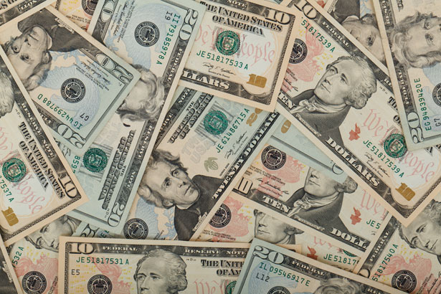
Treasurer’s report
2/16/2023
ASSETS
Checking/Savings
American Rescue Plan Fund 156,091.47
Capital Reserve - DPW 10,728.08
Capital Reserve - Police 4,916.82
Crime Watch Fund 222.69
General Fund - Community 77,217.42
General Fund - FNB 6,059.54
Holiday Lights Fund 1,424.09

Slide 4
Treasurer’s report
Investment - General Fund 1,017.28
Investment - Liquid Fuels 22,346.24
Investment - Paving Fund 1,027.85
Investment - Recycling 5,082.16
Investment - Refuse 2,641.15
Liquid Fuels - FNB 12,054.37
Petty Cash 225.00
Recreations Fund 25,876.89
Recycling - Community 12,656.76
Refuse Checking - FNB 18,571.91
Total Checking/Savings 358,159.72

Slide 5
Treasurer’s report
200000 · Accounts Payable 48,467.30
Long Term Debt 241,117.47

